Slide 1
Subjective Valuations of Well-being
Easterlin and Others

Slide 2
Measurement of well-being
Subjective Scores
  Cannot be easily compared across individuals
  Categories
  Assign numerical values on a scale of 1-10
  Self-anchoring, assign score relative to best possible and worst possible
Can be aggregated for whole country or by groups with characteristics
Non-response tends to be low

Slide 3
Types of self assessment questions
Economic: income
Health
Family life children, parents
Religious life
Employment conditions, job satisfaction
Views of political life, freedom, efficiency of government leaders

Slide 4
Problems in measurement
Stability of responses, given that emotions may play important role
Can individuals assess themselves properly? How to test?
Interpretation of findings: inference of causality
Do the measures reflect utility?
Revelation bias
  People may respond in way they think the interviewer will want them to

Slide 5
Alleges Broad Applicability
Even across cultures variations in results are easily understandable
Economic concerns more important in poor countries or households than rich ones
Paradoxes to be explained
  Individuals say now they are happier than in the past and that this will continue into future
  Yet present happiness remains constant over time

Slide 6
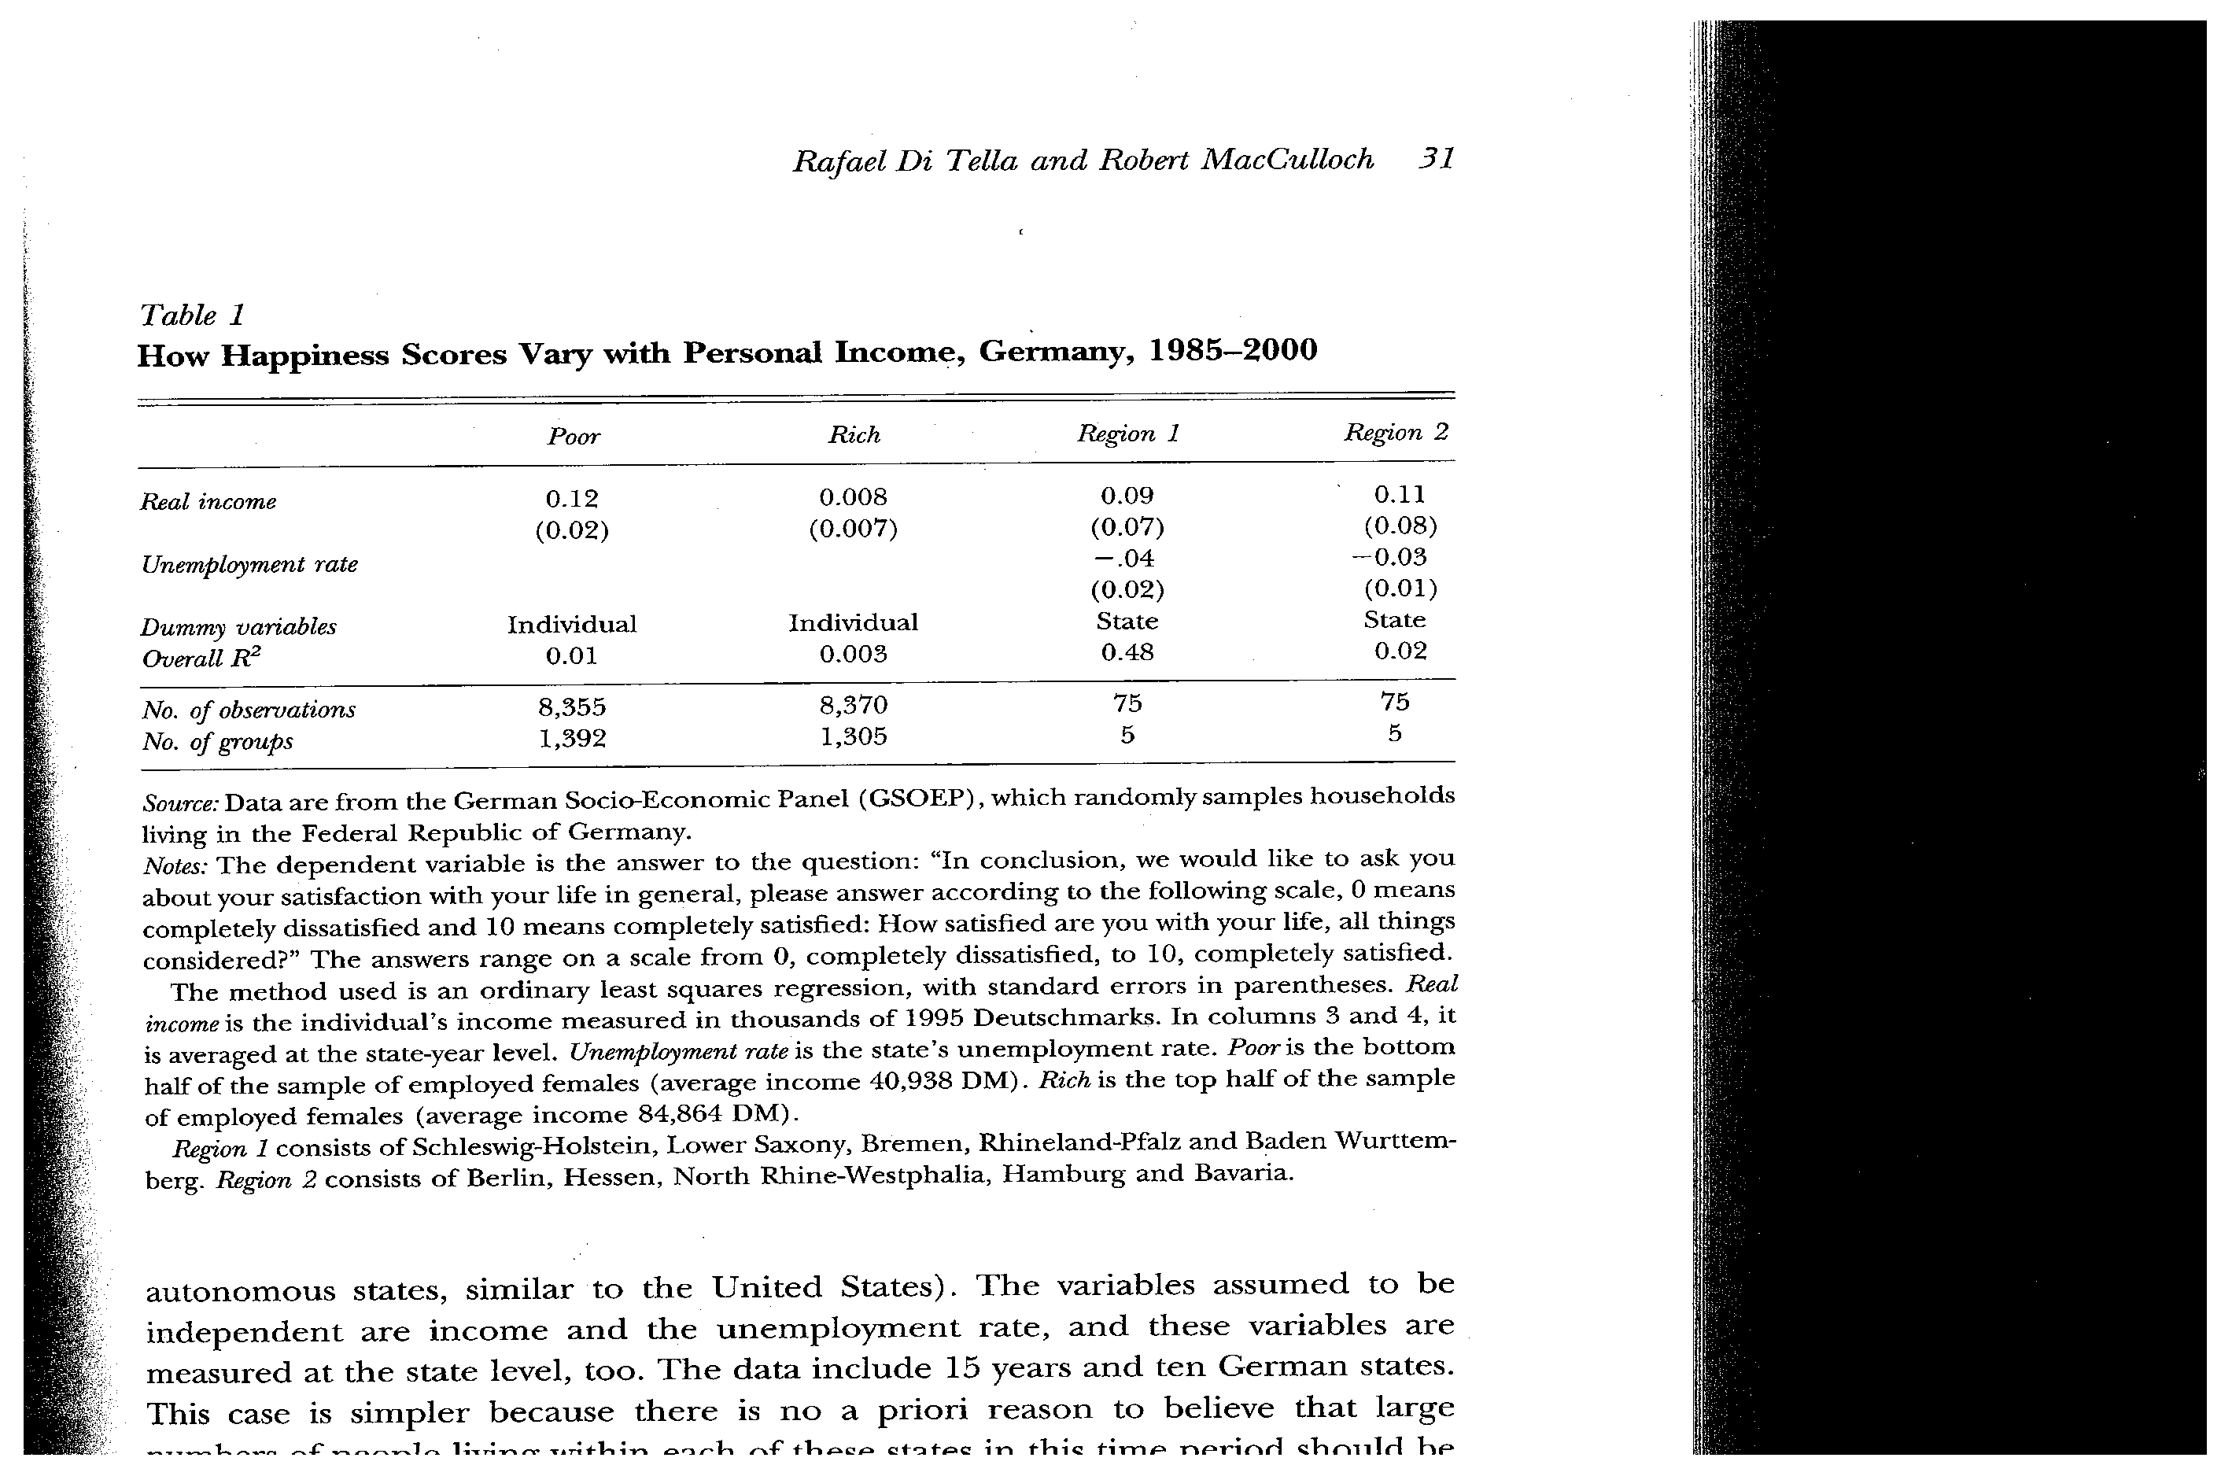

Slide 7
Alternative Explanations for Paradox Easter-lin 2001 ‘I&H Toward a Unified Theory”
Aspirations rise with income
People have different genetics or personalities But this doesn’t explain income differences
More mixing across cultures and income when young. So people see the differences across groups, later on they stay in groups and the differences they see across people are no longer so important . Also habit formation

Slide 8
Types of studies
Cross-sectional
Time Series
Panel
Findings seem to differ among these
  Cross sectional Happiness positive related to income
  Time series, cohort approach sensitive to business cycles, but the relation is very weak
  Explanations for such differences: relative income hypothesis, relative deprivation
  Differential abilities of rich and poor, differential power relations,

Slide 9
Life Cycle Changes
While income and material circumstances tend to rise with age up to retirement, subjective well-being does not rise
Similarly, asking people how they feel relative to the past and expected futures, although varying from person to person does not show much difference relative to the current situation.
Cohort dummies in regression with pooled data do not show significant results
In US, blacks below whites at all ages but the gap seems to be declining over time.

Slide 10
Data on Aspirations
Easterlin shows that what is taken as standard situation and aspirations seem to go up over time.
Hence this may account for the constancy of subjective well being over time.

Slide 11
Aspirations and Change Therein
Subjective
A1
Well-being
A2
A3
P1
P2
P3
With given aspirations
e.g. A1, increases in y
Would raise well-being
But as A shifts down
Higher income is needed
To keep same well-being
y1
y2
y3
Income

Slide 12
Applications Income and Happiness
International Comparisons
Within Country Across Income Groups
INCOME <3 3-5 5-7 7-10 10-15 15+
IN USA 1960
VERY HAPPY 29 33 38 47 49 56
NOT V HAPPY 13 7 7 5 3 4
COUNTRY | HAPPINESS (0-10) | INCOME PER CAPITA 1960
USA | 6.6 | 2790
CUBA | 6.4 | 516

Slide 13
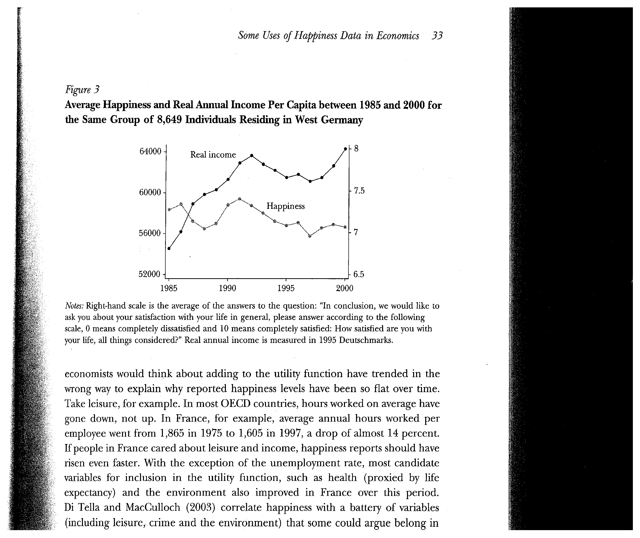

Slide 14
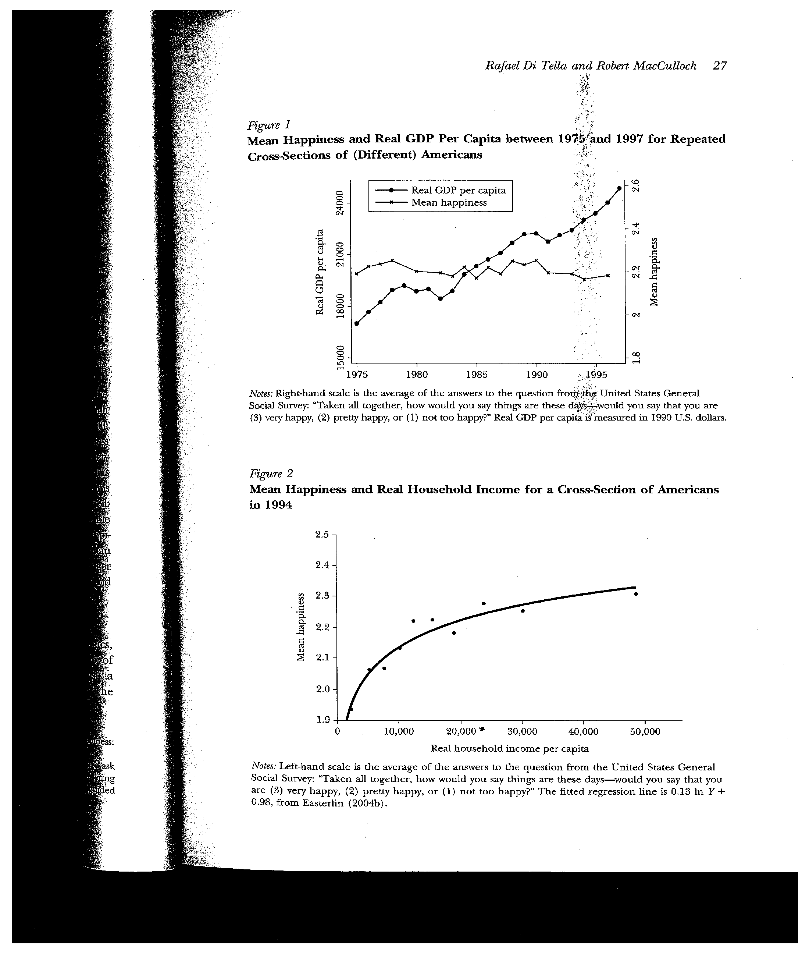

Slide 15
Effects of other differences
Education: more educated happier than less educated, but not rising over time
Marriage may introduce an upward movement but this seems to die out over time.
Health factors
Some applications (oil prices Maggie Switek and I) will the effects be asymmetric between exporters and importers?)
Gender differences
Effects of governance
Stress and just missing winning prize

Slide 16
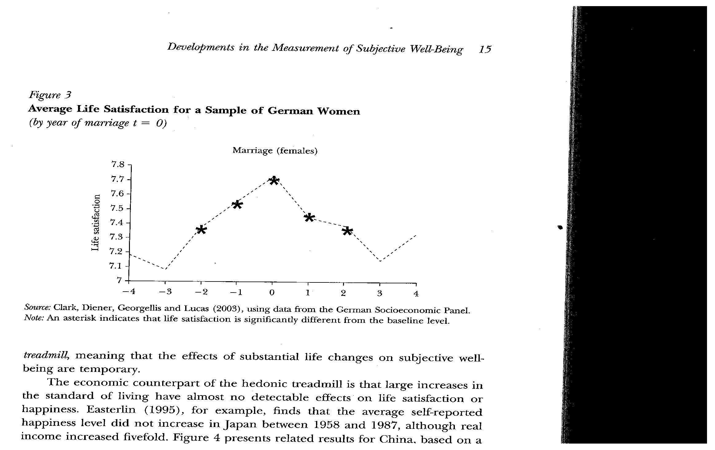
Marriage Example from Kahneman 2006

Slide 17
Various Applications “The Conflict between Aspirations and Resources” (1976)
Demographic Transition: Given that people say “they want to give their children a proper start in life”, see decline in fertility in US earliest in old farm areas where land less available.
Showed that fertility rise and decline over time in US were related to relative income or employment of young men relative to their parents

Slide 18
Other Problems with measures over time with income (di Tella and MacCulloch 2006
Responses could be biased if individual with higher income does not want to acknowledge how happy he is with income,. This could help resolve the paradox as a mis-measurement. For example like those for rich and poor in Table 1, slide 6 above. Notice similarity in the magnitude and significance of the unemployment rate effect in the last two columns of this table.

Slide 19
Relative Income Hypothesis
People compare their situation with their neighbors or reference group, like parents
Tests for such impacts positive:
Luttmer 2004 matching individual income with average income in the locality in US Similar asymmetric effects
Clark 2003 shows that effect of own unemployment is less negative when overall unemployment rate is high

Slide 20
Other Applications
Rural Urban Differences
During large scale political or governance changes (e.g., the Transition Economies
What about countries like Korea or Taiwan where much of their growth success was attributed to long hours and hard work?
Easterlin (1995) showed no increase in Japan despite quadrupling of per capita income

Slide 21
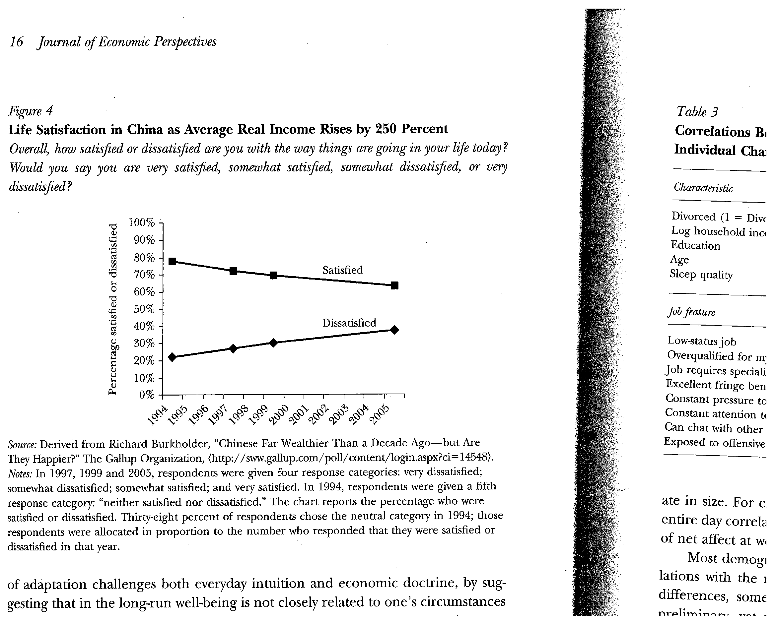

Slide 22
Any factors that have longer lasting effects?
Kahneman and Krueger
Cite Pain, Unemployment
Tests for aspiration treadmill reject it. This based on detailed evaluations of time spent on different activities and their evaluation. Net effects of experience correlate with life satisfaction

Slide 23
Happiness Scores becoming subject of national accounting and welfare
Bhutan: Declares it as national objective
France, UK, Sarkozy Commission has underscored the importance of putting more emphasis on these much broader feelings of people
Political influences?

Slide 24
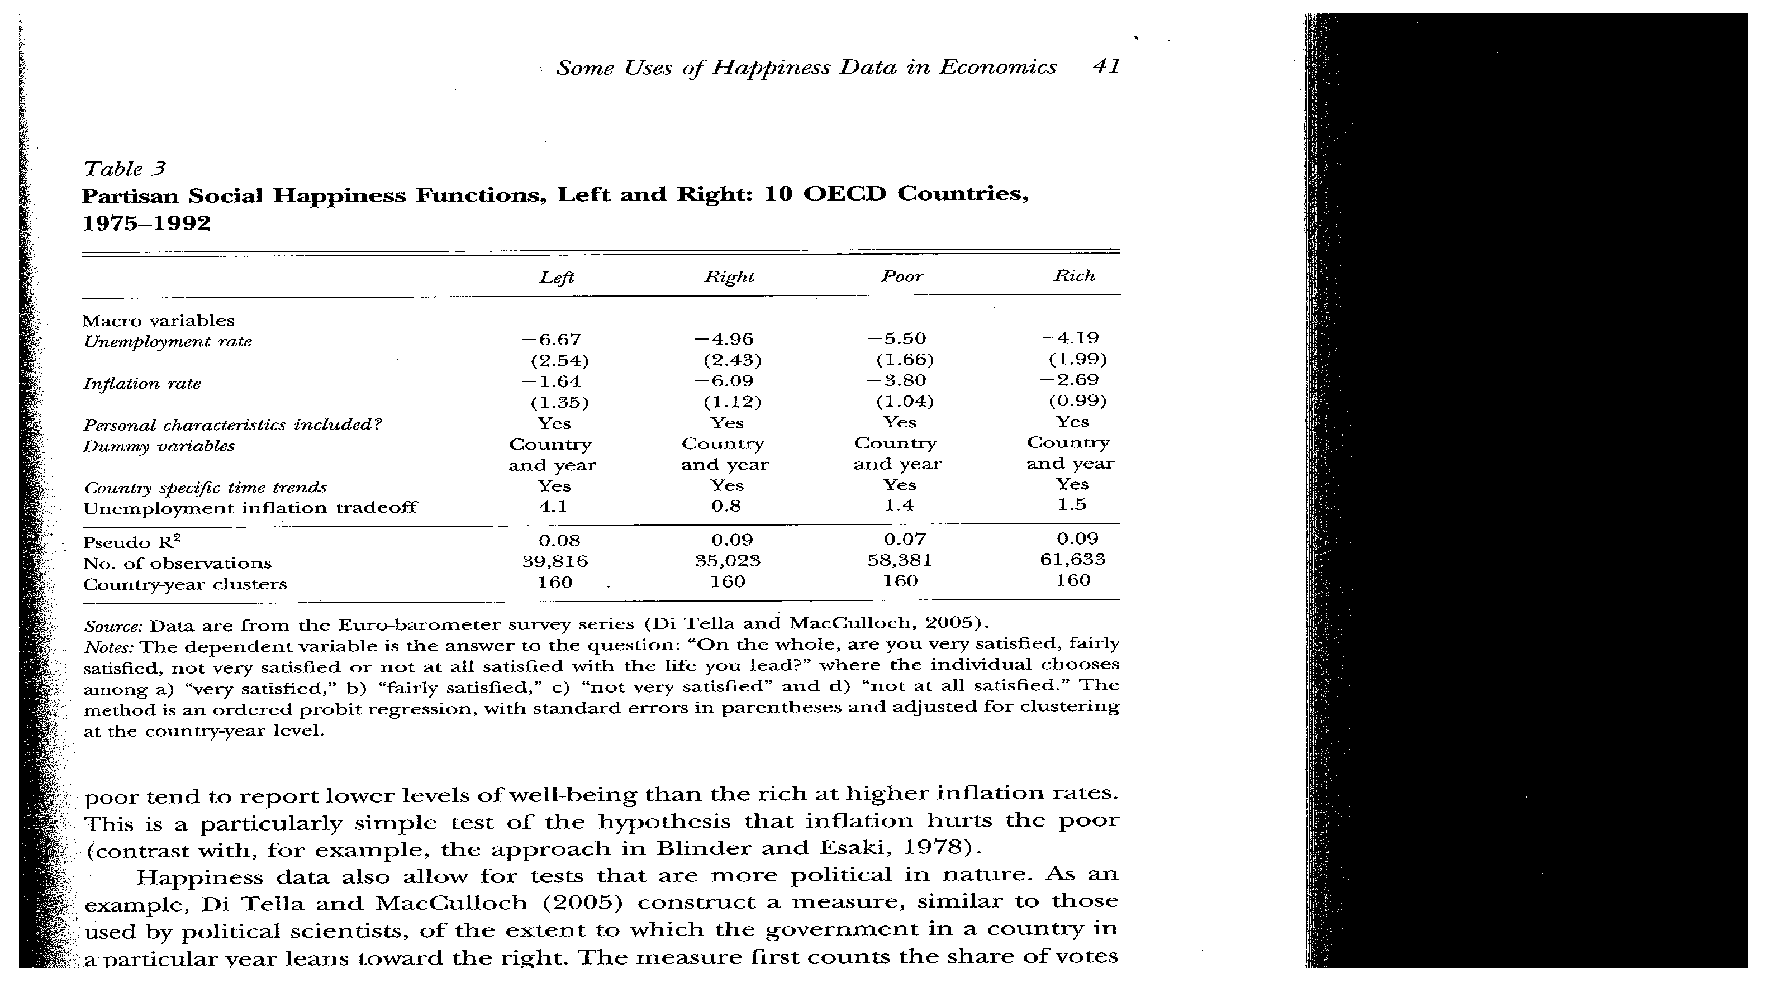

Slide 25
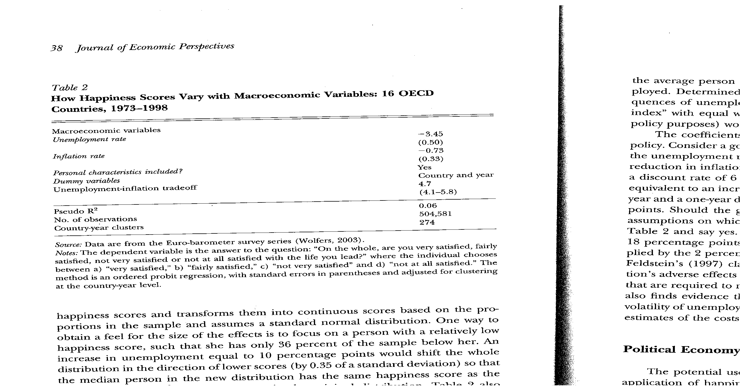
Responses to Macro shocks

Slide 26
Inequality and Beliefs
Different views about rewards to effort US and Europe. Inequality has stronger negative effect on happiness in Europe than US, especially among the poor and political left. Rich left also in the US
Question in WVS about poor people having chance to get out of poverty.

Slide 27
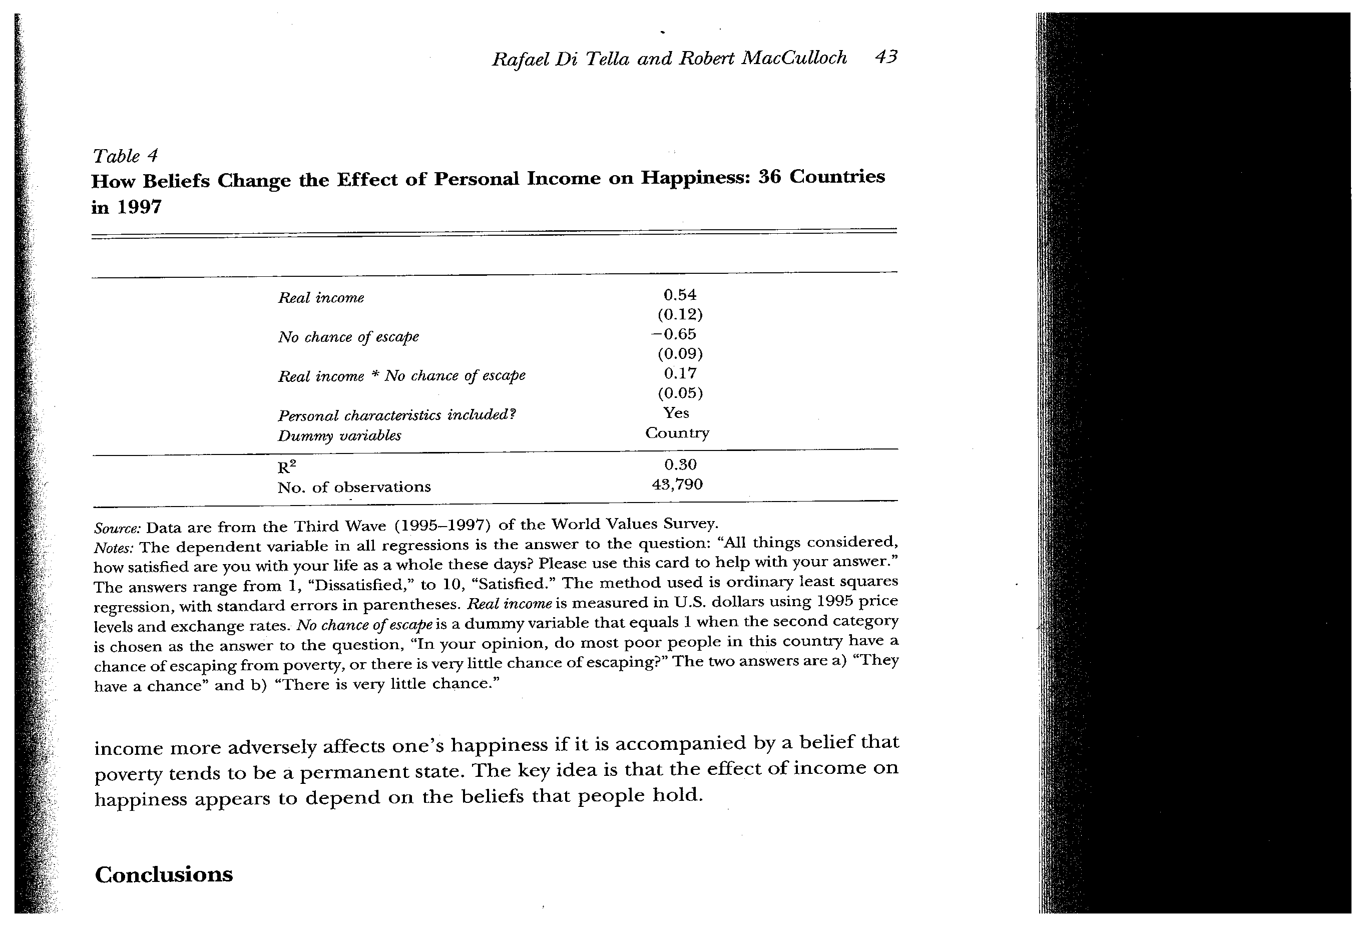

Slide 28
Cross Country comparisons combining that question with income
Note the negative effect of the interaction term of income and pessimistic view about ability to move out of poverty. Thus lower income would have a worse effect on happiness for those who are more pessimistic in this respect.

Slide 29
Bernanke’s USC Commencement Address on Happiness 2010
Why Happiness? Declaration of Independence Inalienable rights to Life, Liberty and the Pursuit of Happiness
People value health, environment
Examples of Easterlin Paradox:
  Lottery winners feel good at first but a month or two later not
  Adam Smith : “mind of every man, in time returns to its natural state of tranquility

Slide 30
Importance of control and adaptability to shocks
Canada Example
    Those receiving unemployment insurance offered jobs in community development and opportunities to develop a social network. Those who participated reported higher satisfaction than those who did not
Examples of people receiving devastating injuries or diseases
Story of Lincoln in carriage seeing pig stuck in the mud . Previously he had said people act to maximize own happiness. He intervened got very muddy and wet

